Slide 1
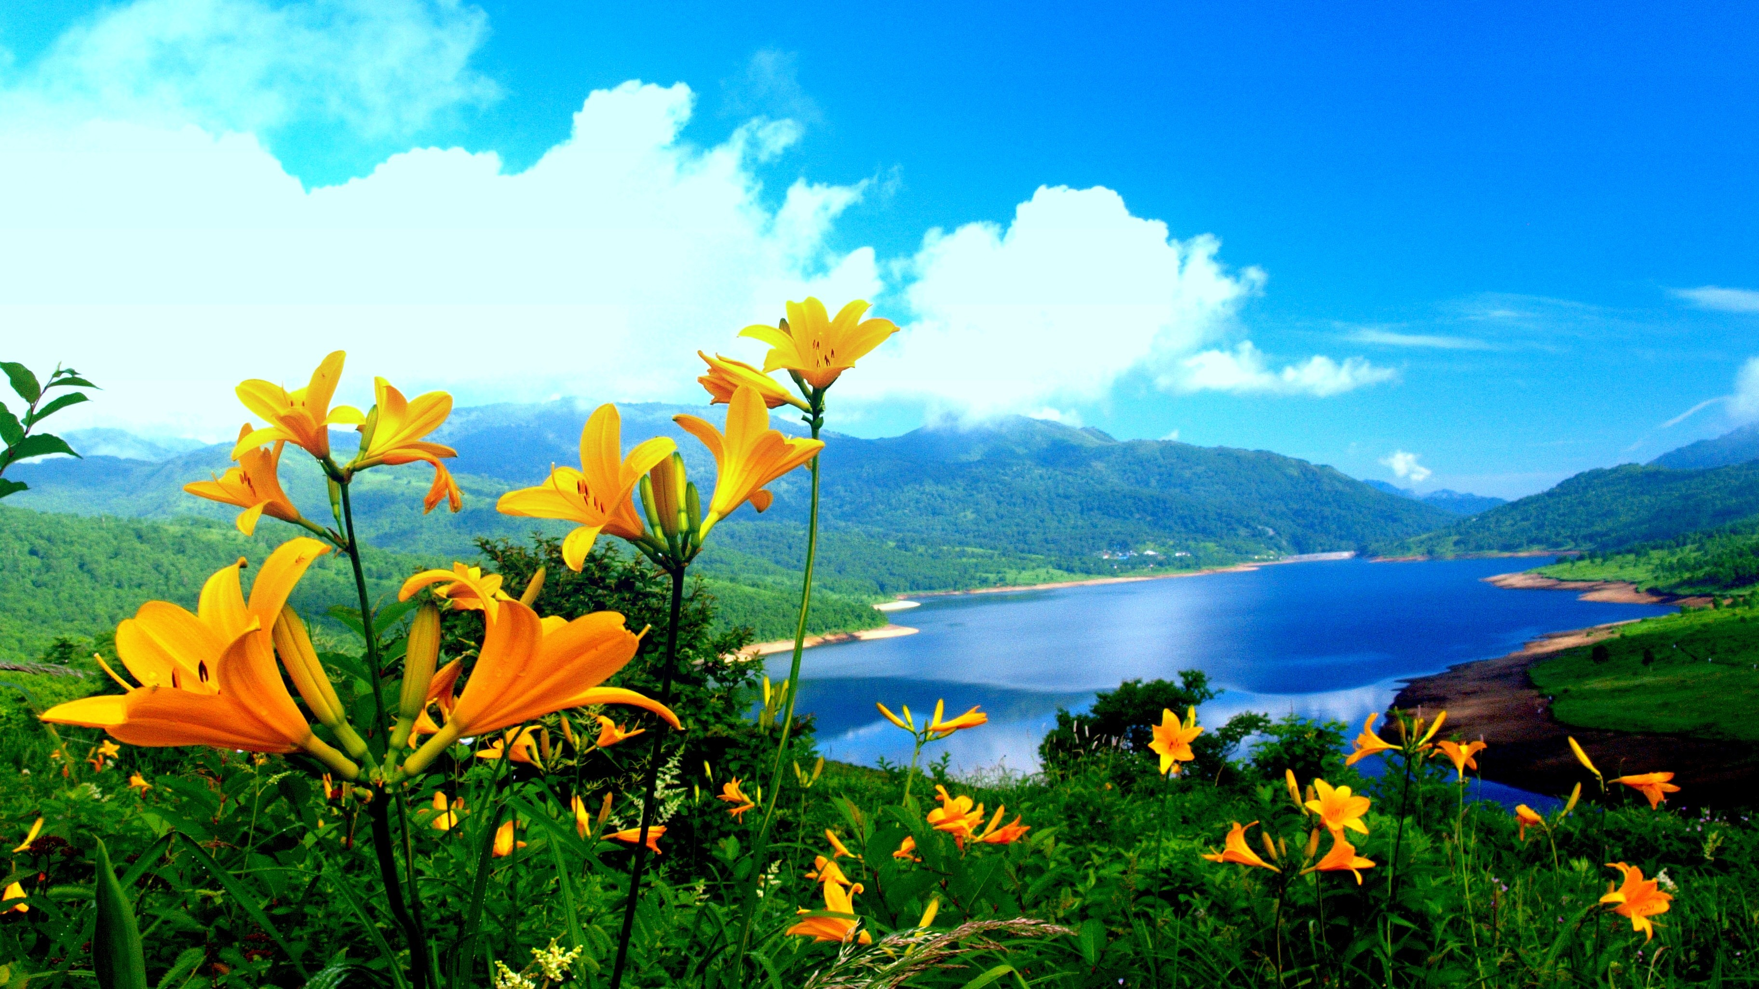
What did we do to the first nations culture
(Catholic Schools)
By: Ishwara Lowtan

